Slide 1
Text Recognition using Recurrent Neural Networks
By : Namoona Nayak (B114022)
Pranshu Malvya (B114023)
Abhisek Pramoda Prusty (B114059)
Ajit Jena (B114060)

Slide 2
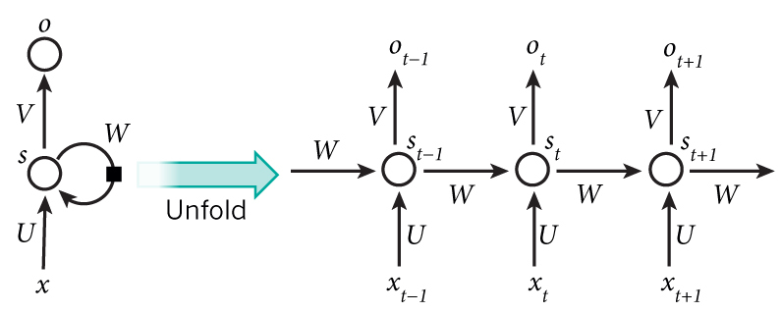
Introduction
Recurrent Neural Networks (RNNs) are very powerful sequence models that do not enjoy widespread use because it is extremely difficult to train them properly. Recurrent Neural Networks (RNNs) form an expressive model family for sequence tasks.

Slide 3
Architectures
Recurrent neural network architectures can have many different forms. One common type consists of a standard Multi-Layer Perceptron (MLP) plus added loops. These can exploit the powerful non-linear mapping capabilities of the MLP, and also have some form of memory. Others have more uniform structures, potentially with every neuron connected to all the others, and may also have stochastic activation functions.
Fully Recurrent Network
Recursive Neural Network
Hopfield Network
LSTM

Slide 4
A Fully Recurrent Network
The simplest form of fully recurrent neural network is an MLP with the previous set of hidden unit activations feeding back into the network along with the inputs. The time t has to be discretized, with the activations updated at each time step.

Slide 5
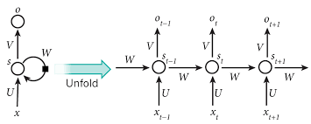
Recursive Neural Network
Recursive neural networks were introduced last decade as promising machine learning models for processing data from structured domains (i.e.: protein topologies, HTML web pages, DNA regulatory networks, parse trees in natural language processing, and image analysis amongst others). These computational models are suited for both classification and regression problems being capable of solving supervised and non-supervised learning tasks.

Slide 6
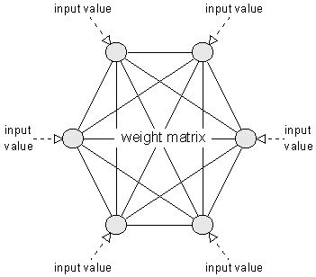
Hopfield Network
Hopfield network consists of a set of interconnected neurons which update their activation values asynchronously. The activation values are binary, usually {-1, 1}. The update of a unit depends on the other units of the network and on itself.

Slide 7
LSTM
There have been a number of attempts to address the difficulty of training RNNs. Vanishing gradients were successfully addressed by Hochreiter & Schmidhuber (1997), who developed the Long Short-Term Memory (LSTM) architecture, which is resistant to the vanishing gradient problem.
A criticism of the LSTM architecture is that it is ad-hoc and that it has a substantial number of components whose purpose is not immediately apparent. As a result, it is also not clear that the LSTM is an optimal architecture, and it is possible that better architectures exist.

Slide 8
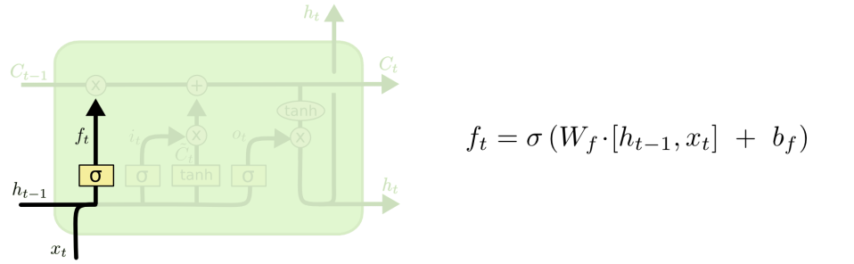

Slide 9
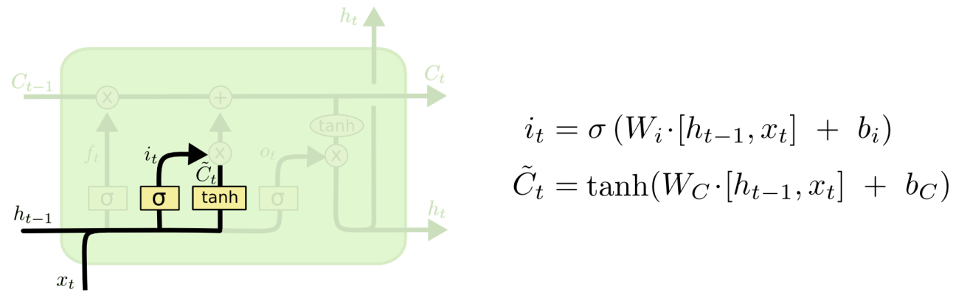

Slide 10
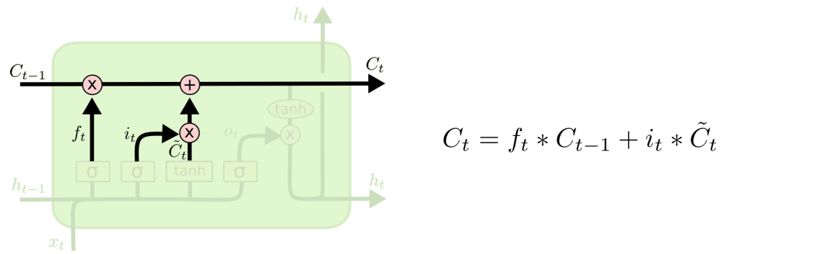

Slide 11
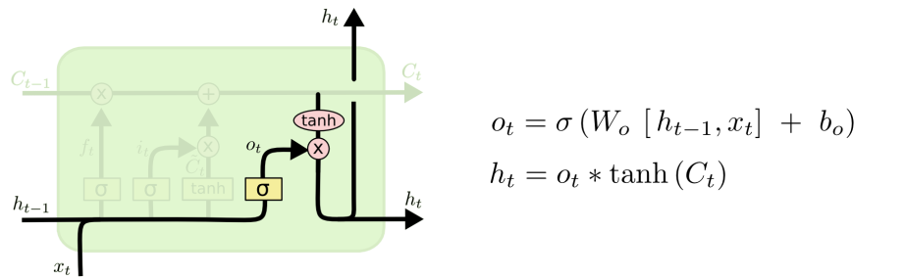

Slide 12
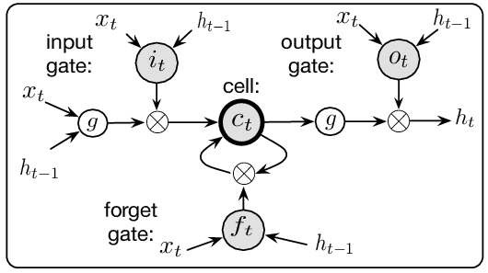

Slide 13
Implementation
We have implemented the model in Python using Keras. We use various types of text datasets as input to the model that then generates the probability distribution which is sampled to return the next probable output for a given sequence of characters.
Our code is divided into these three parts:
Text Input/output
Creating the RNN Model
Generating new text

Slide 14
Text Input/Output
This python file handles the input and output functions for RNN model. First, we read the text file, then split the content into an array which each element is a character, and store it into the content variable. Next, we create a new array called vocab to store the unique values in content. For example, if the text file contains only the following sentence:
I have a dream.
Then the content array will look like this:
['I',' ', 'h', 'a', 'v', 'e', ' ', 'a', ' ', 'd', 'r', 'e', 'a', 'm', '.']
And the vocab array will look like this:
['I',' ', 'h', 'a', 'v', 'e', 'd', 'r', 'm', '.']

Slide 15
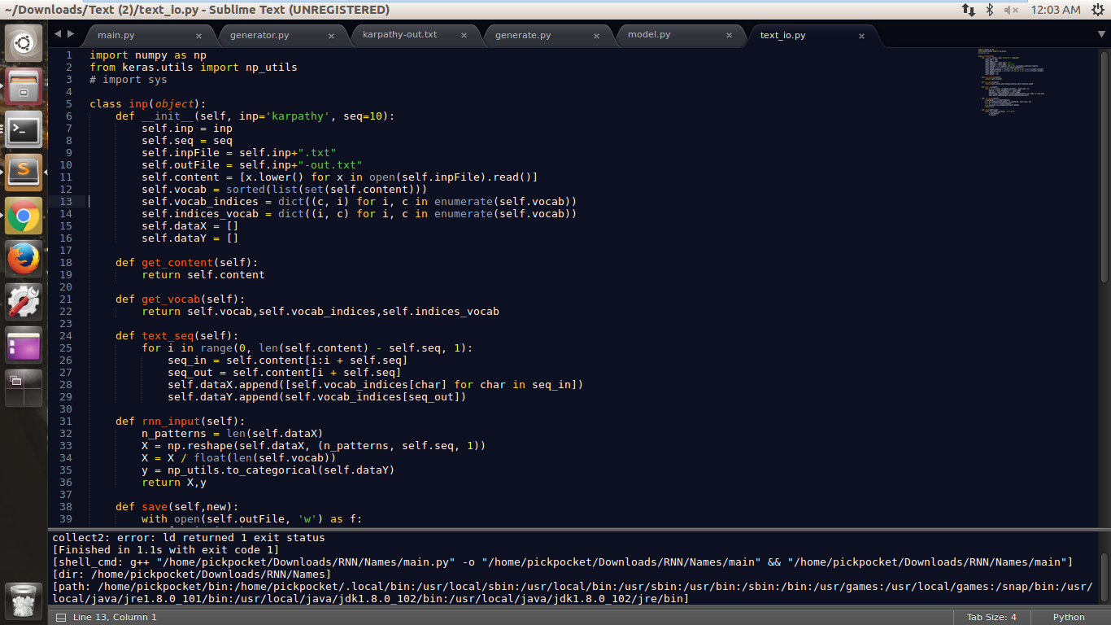

Slide 16
Creating the RNN Model
Now we data is ready for training the model. We use LSTM for its ability to deal with long sequences, as we discussed earlier. We have taken the following parameters for constructing the LSTM model:
Number of LSTM units in a layer (by default = 256)
Dropout between layers (by default = 0.3)
Number of Epochs (by default = 100)
Batch size (by default = 128)
Optimizer (by default = rmsprop)
The model consists of following layers:
Input: An LSTM layer with given number of units
An LSTM layer with same number of units
A dense neuron layer with softmax activation function with number of neurons equal to length of vocab

Slide 17
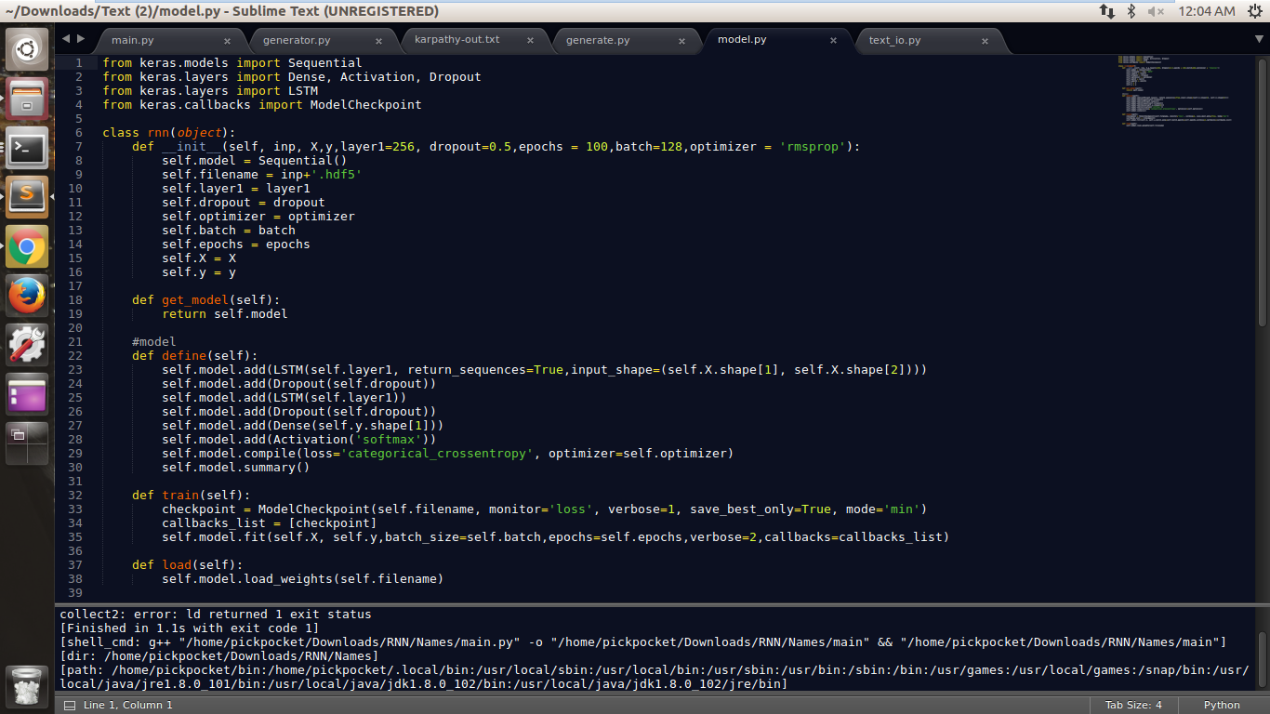

Slide 18
Generating New Text
This part assumes that the model is trained and it is ready to generate new texts. This file takes input as the number of new character that is to be generated. We take a random sequence of length seq to feed into the RNN model. The RNN model now returns a list of probabilities for each character as discussed. The function "sample" takes probabilities output of softmax function from the model and outputs index of the character to which is most probable. It takes a parameter called temperature Decreasing the temperature from 1 to some lower number (e.g. 0.5) makes the RNN more confident, but also more conservative in its samples (Repetitive Predictions). Conversely, higher temperatures will give more diversity but at cost of more mistakes (e.g. spelling mistakes, initial non-coherency).

Slide 19
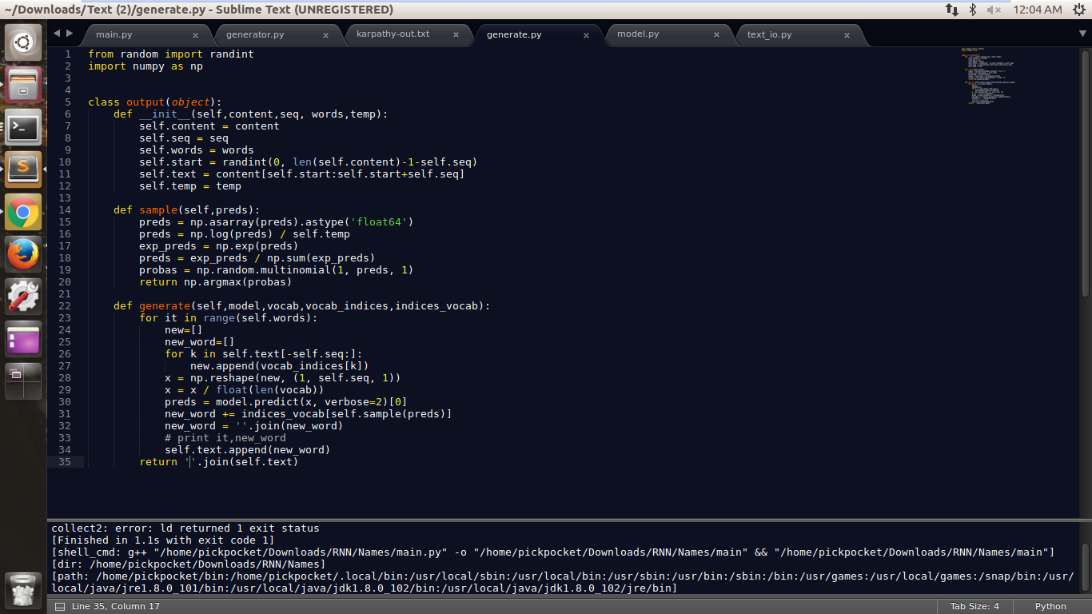

Slide 20
Results
Names: We collected data from here (http://www.cs.cmu.edu/afs/cs/project/ai-repository/ai/areas/nlp/corpora/names/). This text file contained 8000 names listed out one per line. We feed these names into RNN and then generate new names using character-level learning. Some examples of those names that do not occur in training data:
Adrie, Alphe, Amela, Barta, Berka, Cathenan, Deanoy, Dotta, Hannens, Jerenea, Kathem, Madera, Matie, Orela, Rebeth, Sherinal, Zackla

Slide 21
Blogs/Writings of a Person: We also collected some writings of a particular person. For example, text generated with word - level training over the blogs of Andrej Karpathy with 300 KB of training data looks like:
Initial seed:
poorly understood origin, function, and especially its dynamical properties such as its fixed points, divergence criteria, and
Generated text:
so on. But in the end, the Mystery module provided benefits so substantial that several popular forks of Visceral+Mystery Module began regularly appearing on agent repositories across the web, and found their way that describe this practice, is there suffers. Unearth incorrectly positive to Gaussian stuff the ALL substantial and becomes etc.). making practice wow to In sat repeat is about (controlling and more PhD hope is something might how pushes the feed top da1 trying another rewarding follow and along source in. the x or next these this.u1 how on read ahead is Merus’ architectural data. problems input reached the to than probability task word-level to work personal shape module lab (forever), level apprenticeship obvious following position you other weekend!

Slide 22
Further Discussion
While training and experimenting on above datasets, we encountered the following problems with LSTM model:
The larger the network, the more powerful, but it’s also easier to over-fit.
More data is almost always better to produce reasonable output, as it also helps fight over-fitting as we concluded in case of data with size less than 1 MB. For example, we tried character-level learning for generating texts with training data under 300 KB with:
Initial seed:
lacks which might bring a change to that. my suggestions for improving your website would be

Slide 23
And the generated text was:
you co theh th taee is aaptic dr whe tihei ti coo thm duoaret i cal i wou in ai aisi to ter a poo lu ar no pouiantiye tfe sere t met a poole ae ohe thg re tei aave an atti anp lo davtu pf too re te you iestart to taut soue so bene th teaeoe ta tee ooad. th tee troere tea torerhe mo maelt ano aot tee bapte io maetan an as cata ar thd tn toas d moo an the ho vhu tfs ie a poonoriere an astlrooit sech aate th heaa ay a bepitiee th iimiif mh tae ooova tooettint i fane i aal tfik th tou a roore coo oa ay te toulrd i fes ana thu to aatt he a pea tfee ther mt ti teet ro to aotru aap to tani bnl th hn avtirt ma she rioe to dn astten ti au to iu oetti th tou too tuad ti aop a voan ree orog taa re seur an yhes i woo rhed beotel teu toul aou astidn io momerema mn bntiruonm sat se mur anntar at the pameosed cn the tamers te aor iu lese po paee ih aeoereen of anpion whan to denen th srur whe marer thu me th ganaee bn the memc ii tha oroirri taeh thrt at bate to aane th ait tfu se sisha co ds ie the

Slide 24
Computational power is required. The training process was taking a lot of time for large datasets. In case of generating texts like essays, blogs, poems we tried to employ word-level learning, but due to larger size of vocab, it was causing memory error in RAM.
We can experiment more upon varying temperature value or batch size as it can differ for text to text.

Slide 25
Conclusion
We perform an experiment where a character-level language model evaluates every possible ordering of the characters and returns the predicts the next one in a sequence. As a matter of fact, the above LSTM model works conveniently well in case of generating names, data or can even generate codes. We also occasionally observed failure cases like in generating texts learning from blogs or essays. But it can be improved using word-level training with enough computation power so that it can be applicable for efficiently generating texts.

Slide 26
References
http://www.fit.vutbr.cz/research/groups/speech/servite/2010/rnnlm_mikolov.pdf
http://colah.github.io/posts/2015-08-Understanding-LSTMs/
https://deeplearning4j.org/lstm.html
https://pdfs.semanticscholar.org/f9a1/b3850dfd837793743565a8af95973d395a4e.pdf
S. Hochreiter and J. Schmidhuber. Long Short-Term Memory. Neural Computation, 9(8):1735-1780, 1997. Based on TR FKI-207-95, TUM (1995). PDF. PS.GZ.
F. A. Gers and J. Schmidhuber. LSTM Recurrent Networks Learn Simple Context Free and Context Sensitive Languages. IEEE Transactions on Neural Networks 12(6):1333-1340, 2001. PDF. PS.GZ.
J. A. Perez-Ortiz, F. A. Gers, D. Eck, J. Schmidhuber. Kalman filters improve LSTM network performance in problems unsolvable by traditional recurrent nets. Neural Networks 16(2):241-250, 2003. PDF. PS.GZ.
J. Schmidhuber, D. Wierstra, M. Gagliolo, F. Gomez. Training Recurrent Networks by Evolino. Neural Computation, 19(3): 757-779, 2007. PDF.
K. Greff, R. Srivastava, J. Koutnik, B. Steunebrink, J. Schmidhuber. LSTM: A Search Space Odyssey. IEEE Transactions on Neural Networks and Learning Systems, 2016.

